Slide 1
VIVA-VOCE
DIAGNOSIS OF ACUTE DISEASES IN VILLAGES & SMALLER TOWNS USING AI
Batch Number: 24
Roll Number
20211CSE0229
20211CSE0224
20211CSE0223
Student Name
SHREYA RAVI KUMAR
NEHA R
SNEHA R
Under the Supervision of,
Dr. Ramesh Sengodan
Professor
School of Computer Science Engineering & Information Science
Presidency University

Slide 2
Introduction
Many people find it difficult to access healthcare in India due to a shortage of doctors, particularly in smaller towns and villages. This issue has also made it difficult for telemedicine and other technologies to scale up in the past. In the era of digital assistants like Google and Alexa, we have developed an artificial intelligence-based "doctor" that is capable of diagnosing acute illnesses using a simple user interface. Some features are:
User-Friendly Interface: Intuitive and accessible design for users of all ages, ensuring ease of navigation and interaction.
Symptom Checker: Allows users to input symptoms and receive preliminary assessments for conditions.
AI-Powered Diagnostics: Utilizes advanced machine learning algorithms to analyze user data and provide accurate diagnoses based on input symptoms (and medical history.)

Slide 3
Literature Review
NAME | DESCRIPTION | ADVANTAGES | DISADVANTAGES
Harnessing AI for Early Detection of Cardiovascular Diseases: Insights from Predictive Models Using Patient Data.Research by Ali Husnain et al. (2024). | The article explores how artificial intelligence (AI) can enhance early detection of cardiovascular diseases (CVDs) by using predictive models based on ECGs, wearable data, and medical histories. It highlights that Gradient Boosting achieved 92% accuracy in identifying high-risk patients, while also addressing the need for real-world validation and ethical considerations in AI integration into clinical practice. | Strong model performance was guaranteed by cross-validation and hyperparameter adjustment. | Ensuring that AI systems are trained on diverse, representative datasets will be crucial to prevent biases and ensure that these technologies benefit all populations. Regulatory and ethical frameworks will also need to evolve to ensure that AI in healthcare is safe, transparent, and aligned with patient rights.
The Use of AI in Detecting Rare Diseases.Research by Ugwu Okechukwu P.C.et al. (2024). | The article examines the role of artificial intelligence (AI) in detecting rare diseases, which affect fewer than 1 in 2,000 individuals. It highlights how AI can enhance diagnostic accuracy and reduce the lengthy diagnosis process by analyzing large datasets, symptoms, and genetic information. The paper also discusses case studies demonstrating AI's effectiveness and addresses ethical considerations, such as data bias and privacy concerns, in its implementation for better patient outcomes. | Transform the detection and treatment of uncommon diseases while urging careful evaluation of the ethical ramification. | Privacy concerns and biases in training datasets.
Notes:
Harnessing AI for Early Detection of Cardiovascular Diseases: Insights from Predictive Models Using Patient Data: Research by Ali Husnain et al. (2024). The article explores how artificial intelligence (AI) can enhance early detection of cardiovascular diseases (CVDs) by using predictive models based on ECGs, wearable data, and medical histories. It highlights that Gradient Boosting achieved 92% accuracy in identifying high-risk patients, while also addressing the need for real-world validation and ethical considerations in AI integration into clinical practice.
The Use of AI in Detecting Rare Diseases: Research by Ugwu Okechukwu P.C.et al. (2024). The article examines the role of artificial intelligence (AI) in detecting rare diseases, which affect fewer than 1 in 2,000 individuals. It highlights how AI can enhance diagnostic accuracy and reduce the lengthy diagnosis process by analyzing large datasets, symptoms, and genetic information. The paper also discusses case studies demonstrating AI's effectiveness and addresses ethical considerations, such as data bias and privacy concerns, in its implementation for better patient outcomes.
Towards a Chatbot for Medical Diagnosis Based on Patient Symptoms: Research by Ugwu Yaya Traoré.et al. (2024).This article explores the development of a chatbot designed to assist in medical diagnosis by analyzing patient symptoms. It highlights the potential benefits of utilizing AI technology in healthcare settings, aiming to enhance diagnostic accuracy and accessibility.

Slide 4
NAME | DESCRIPTION | ADVANTAGES | DISADVANTAGES
Towards a Chatbot for Medical Diagnosis Based on Patient Symptoms.Research by Ugwu Yaya Traoré.et al. (2024). | This article explores the development of a chatbot designed to assist in medical diagnosis by analyzing patient symptoms. It highlights the potential benefits of utilizing AI technology in healthcare settings, aiming to enhance diagnostic accuracy and accessibility. | Streamlines the diagnostic process, quickly gathering patient data and providing AI-generated analysis, allowing doctors to focus more on patient care. | May lead to incorrect diagnoses if the information provided is incomplete or inaccurate.
Review of Artificial Intelligence Techniques in Imaging Data Acquisition, Segmentation, and Diagnosis for COVID-19. Research by Feng Shi .et al. (2021). | AI technologies have greatly improved imaging workflows by automating procedures, enhancing efficiency, and minimizing contact between patients and healthcare workers, thereby lowering infection risks. AI assists in precise image acquisition, segmentation, and diagnosis, offering essential support to medical professionals in detecting infections and making clinical decisions. The review highlights the necessity for continued advancement of AI applications in imaging to ensure optimal scan quality and safety. | AI provides safe, accurate and efficient imaging solutions in COVID-19 applications. | The imaging data in COVID-19 applications may have incomplete, inexact and inaccurate labels, which provides a challenge for training an accurate segmentation and diagnostic network.
Notes:
Review of Artificial Intelligence Techniques in Imaging Data Acquisition, Segmentation, and Diagnosis for COVID-19: Research by Feng Shi .et al. (2021). The COVID-19 pandemic has underscored the vital role of medical imaging, especially X-ray and CT scans, in diagnosing the disease, particularly when RT-PCR tests fall short. AI technologies have greatly improved imaging workflows by automating procedures, enhancing efficiency, and minimizing contact between patients and healthcare workers, thereby lowering infection risks. AI assists in precise image acquisition, segmentation, and diagnosis, offering essential support to medical professionals in detecting infections and making clinical decisions. The review highlights the necessity for continued advancement of AI applications in imaging to ensure optimal scan quality and safety.
Artificial Intelligence (AI) in Rare Diseases: Is the Future Brighter?: Research by Sandra Brasil et al. (2019). The amount of biomedical data is increasing, and AI, particularly deep learning, holds great promise in rapidly collecting, analyzing, and characterizing this information. Rare diseases (RDs), which are severely underrepresented in research, can benefit from AI technologies that can integrate and analyze data from different sources to overcome challenges such as low diagnostic rates and reduced patient numbers. This review aims to summarize the AI approaches being used in RDs, including a section on congenital disorders of glycosylation as a potential study model.

Slide 5
NAME | DESCRIPTION | ADVANTAGES | DISADVANTAGES
Artificial Intelligence (AI) in Rare Diseases: Is the Future Brighter? Research by Sandra Brasil et al. (2019). | The amount of biomedical data is increasing, and AI, particularly deep learning, holds great promise in rapidly collecting, analyzing, and characterizing this information. Rare diseases (RDs), which are severely underrepresented in research, can benefit from AI technologies that can integrate and analyze data from different sources to overcome challenges such as low diagnostic rates and reduced patient numbers. This review aims to summarize the AI approaches being used in RDs, including a section on congenital disorders of glycosylation as a potential study model. | AI algorithms performing mutation detection, prediction, and classification can take RDs’ diagnosis to the next level, increasing these figures and uncovering new disease mechanisms and therapeutic targets. | Dispersed, unstructured, and poorly annotated clinical information presented across medical literature, EHRs, and patient registries worldwide constitutes a greatly untapped resource.
AI and Big Data: A New Paradigm for Decision Making in Healthcare. Research by Panagiota Efthymiou et al. (2020). | Recent advancements in AI, especially in healthcare, help doctors make better decisions by analyzing large amounts of medical data. AI tools can predict outcomes, assist with diagnoses, and improve treatments. However, using AI effectively requires updating medical education so doctors can oversee these systems and ensure patient safety. Policies on privacy, data sharing, and accountability play a key role in AI's spread. While AI brings great potential, it’s crucial for healthcare providers to balance technology with human oversight to avoid risks and ensure better patient outcomes. | Implementation of artificial intelligence to the bedside has the ability to alter the conventional position of the physician and nurse. | Sensitive patient information may be vulnerable to breaches or misuse.
Notes:
AI and Big Data: A New Paradigm for Decision Making in Healthcare - Research by Panagiota Efthymiou et al. (2020). Recent advancements in AI, especially in healthcare, help doctors make better decisions by analyzing large amounts of medical data. AI tools can predict outcomes, assist with diagnoses, and improve treatments. However, using AI effectively requires updating medical education so doctors can oversee these systems and ensure patient safety. Policies on privacy, data sharing, and accountability play a key role in AI's spread. While AI brings great potential, it’s crucial for healthcare providers to balance technology with human oversight to avoid risks and ensure better patient outcomes.
A Review of the Role of Artificial Intelligence in Healthcare - Research by Ahmed Al Kuwaiti et al. (2023). The transformative impact of artificial intelligence(AI) on healthcare, emphasizing its ability to enhance clinical decision-making, improve diagnostic accuracy, and streamline administrative processes, also highlighting the integration of AI in electronic health records and patient engagement, which can lead to more personalized and efficient care.
Impact of Artificial Intelligence on Healthcare: A Review of Current Applications and Future Possibilities - Research by A. Ramalingam et al. (2023).The current applications of artificial intelligence (AI) in healthcare, highlighting its effectiveness in areas such as diagnostics, treatment planning, and patient management. It discusses various AI technologies, including machine learning and natural language processing, and their potential to enhance clinical outcomes and operational efficiency. Additionally, the paper explores future possibilities for AI in healthcare, emphasizing the need for ethical considerations and robust regulatory frameworks

Slide 6
NAME | DESCRIPTION | ADVANTAGES | DISADVANTAGES
A Review of the Role of Artificial Intelligence in Healthcare.Research by Ahmed Al Kuwaiti et al. (2023). . | The transformative impact of artificial intelligence(AI) on healthcare, emphasizing its ability to enhance clinical decision-making, improve diagnostic accuracy, and streamline administrative processes, also highlighting the integration of AI in electronic health records and patient engagement, which can lead to more personalized and efficient care. | Support medical imaging and diagnostic services, fight the pandemic, provide virtual patient care, increase patient engagement and adherence to treatment plans, reduce the administrative burden on healthcare professionals | A disadvantage of AI in healthcare is the overfitting issue, where algorithms may make inaccurate predictions due to numerous variables affecting patient outcomes, leading to poor decision-making and reduced reliability of AI systems.
Impact of Artificial Intelligence on Healthcare: A Review of Current Applications and Future Possibilities - Research by A. Ramalingam et al. (2023). | The current applications of artificial intelligence (AI) in healthcare, highlighting its effectiveness in areas such as diagnostics, treatment planning, and patient management. It discusses various AI technologies, including machine learning and natural language processing, and their potential to enhance clinical outcomes and operational efficiency. Additionally, the paper explores future possibilities for AI in healthcare, emphasizing the need for ethical considerations and robust regulatory frameworks | Treatment to an individual's genetic makeup, lifestyle, and environment. | Bias and discrimination are also major ethical concerns with the use of AI in healthcare

Slide 7
Research Gaps Identified
• Lower accuracy performance of the Support Vector Machine highlighted inverse complexity.
• The use of retrospective data and the biases present in electronic health records (EHRs) could affect how well these results generalize.
• AI models may inherit biases from training data, potentially leading to unequal treatment across different demographic groups. This makes ensuring fairness and transparency a challenge.
• Clinical deployment requires rigorous testing and validation in real-world settings to ensure reliability.
• Predictive models like Gradient Boosting can struggle with real-world accuracy due to overfitting or biased data.
• AI models in imaging require large, high-quality datasets, which can be challenging to obtain due to privacy and regulatory constraints.

Slide 8
Reliance on AI can reduce physicians' independent decision-making, potentially leading to over-dependence on technology.
• AI technologies can enhance efficiency and accuracy, they may lack the human touch and emotional understanding necessary for effective patient care. Human oversight ensures that patients receive compassionate care and have a trusted healthcare provider who can address their concerns and provide emotional support.

Slide 9
Proposed Methodology
With the help of AI and machine learning techniques, a basic user interface (UI) made with HTML and CSS can be created that enables users to quickly submit their symptoms and obtain a medical diagnosis.
This user interface consists of text fields for users to enter their symptoms, a button to submit the data, and a results section that shows the projected illness.
To assess input symptoms and determine the most likely ailment, the system's backend utilizes machine learning algorithms like Random Forest Classifier and XGBoost.
The model's performance is evaluated using accuracy, supporting early identification and preventive healthcare practices.
Because the interface is so simple, even people with little technological expertise can readily interact with the system.
After preprocessing, the data is split into training and testing sets.
Random Forest constructs decision trees from various data subsets and combines their predictions.
Model evaluation through accuracy helps medical professionals identify diabetes early and treat it effectively.
XG Boost begins by loading and analyzing the parkinsons dataset, separating the labels (which indicate the condition of the disease) from the input data (which are features). It partitions the data into training (85%) and testing (15%) sets and scales the features for consistency.

Slide 10
Objectives
Precise Disease Prediction: The software ought to accurately estimate the sickness or diseases the patient may have depending on the symptoms entered. Make use of complex models that have been trained on big datasets.
Simple User Interface: Patients and healthcare professionals should be able to enter symptoms into the software with ease owing to an intuitive interface.
Continuous Learning and Improvements: Keep the software updated with the most recent medical research and changing disease trends, and make sure it learns from fresh data.
Assistance in Diagnostics for Medical Professionals: To give medical practitioners a decision support tool or diagnostic recommendations to help them. The software is able to produce predictions along with supplementary data, like diagnostic standards or possible tests required for validation.
Adherence to Medical Standards: The system complies with national and international health regulations and medical diagnostic standards. Update the system periodically to reflect the most recent diagnostic standards, clinical recommendations, and methods for treatment.

Slide 11
System Design & Implementation
• Python libraries: numpy, pandas, matplotlib, seaborn, scaler
• Machine learning algorithms: Random Forest Classifier, XG Boost
•Medical data can be transformed into predictive models with machine learning techniques like decision trees and support vector machines.
•These algorithms are able to identify trends, learn from patient data, and accurately predict the diagnosis of diseases.
•Flask is a web-based tool that may be accessed via a browser instead of being a stand-alone desktop program. The application can be used by users from any web-browsing device, making deployment and accessibility simple.

Slide 12
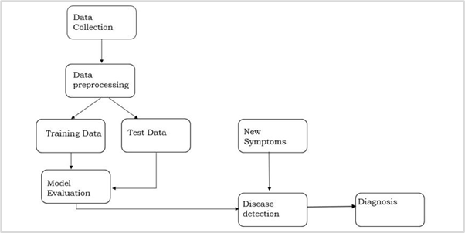

Slide 13
The system begins by creating an intuitive user interface, like a website, where users may enter their symptoms, specific health factors, and optional health information.
The backend has programming that maps diseases patterns to indicators and other risk factors.
When making predictions, a machine learning model or rule-based algorithm that has been trained on past medical data analyzes the inputs and suggests potential diagnoses along with probability levels.
To assess input symptoms and determine the most likely disease, the system's backend employs machine learning techniques like XGBoost and Random Forest Classifier.
The Random Forest method generates a large number of decision trees and averages their predictions.
Patients are classified as either at risk or not for heart disease after the dataset has been divided into training and testing groups.
In order to evaluate the model's effectiveness and encourage early identification and preventative medical measures, accuracy is utilized.

Slide 14
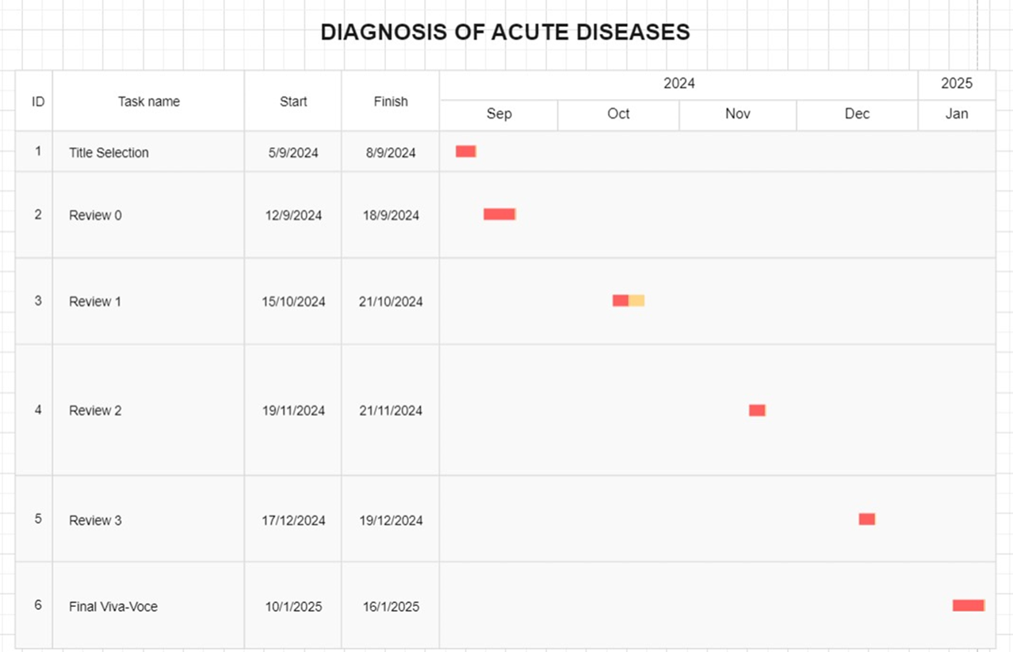
Timeline of Project

Slide 15
Outcomes / Results Obtained
Using data analysis and machine learning models, the illness prediction program predicts possible acute diseases based on user input.
Using a Random Forest classifier on a dataset of 1,025 entries, it achieved 98.5% accuracy for heart disease predictions and 87.6% accuracy for diabetes predictions on 768 entries, demonstrating its excellent accuracy rates.
Using a dataset of 195 items, an XGBoost model for Parkinson's disease predictions produces an accuracy of 96.67%. Because of its ease of use, even those without technical knowledge may utilize its capabilities, and because it makes predictions almost instantly, it is appropriate for urgent circumstances. However, the quality of the data may restrict its accuracy in complex circumstances, and it shouldn't be used in place of expert medical diagnoses.
Using cutting-edge machine learning models and tackling moral issues like user privacy and bias in training data could be future improvements. All things considered, the program appears to have potential for raising healthcare accessibility and awareness, promoting early disease identification, and acting as a useful addition to the healthcare ecosystem.
It has the potential to be a key instrument in integrating technology and medicine, enabling personalized healthcare solutions, with further development.

Slide 16
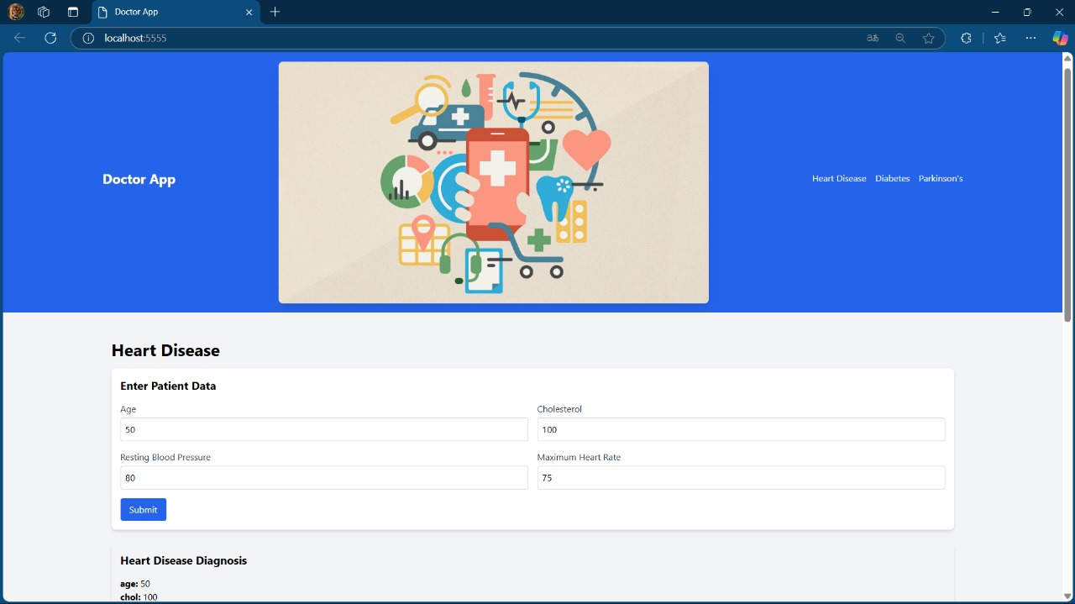
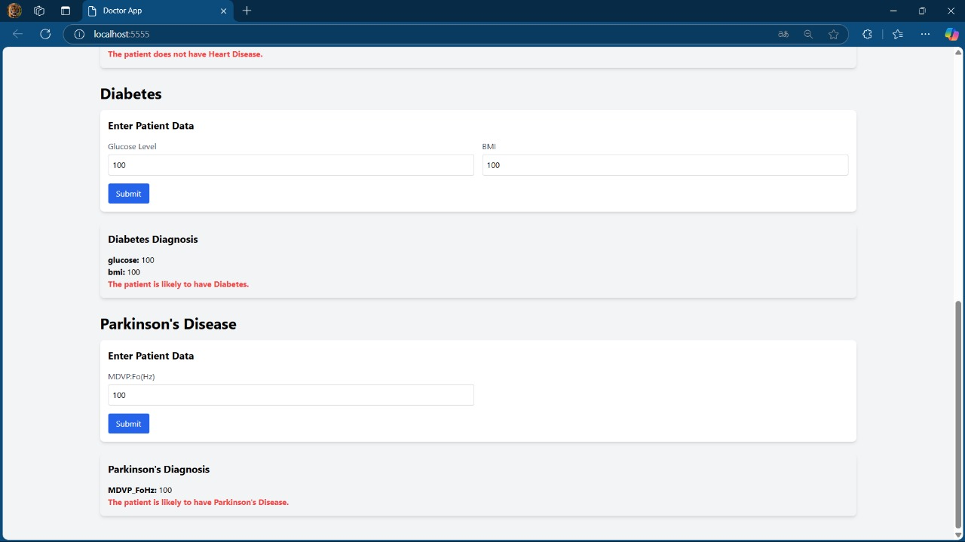

Slide 17
Conclusion
Software that uses Artificial Intelligence(AI) and user-reported symptoms to predict diseases is not a substitute for expert diagnosis; rather, it is an additional tool for medical decision-making. Large volumes of data may be efficiently analyzed by AI technologies, especially those that use machine learning, which can spot trends that human doctors would miss. However, when diagnoses result in unfavorable results, the lack of transparency in AI models raises questions regarding accountability and trust. As AI is included into diagnostics, ethical concerns must also be taken into account, such as the possibility of medical personnel losing their jobs. Notwithstanding these obstacles, AI-powered diagnostic technologies can improve accuracy and efficiency, especially in underprivileged areas, and reduce the strain of medical professionals. In the end, even while AI can empower people and improve the delivery of healthcare, it must always be used under human supervision to ensure ethical decision-making.

Slide 18
References
Nafiseh Ghaffar Nia, Erkan Kaplanoglu et al. (2023) ‘Evaluation of artificial intelligence techniques in disease diagnosis and prediction’.
Mohammed Naseeruddin Taufiq, Bandaru Bhavagna Shreya et al. (2024) ‘Diagnosis Of Acute Diseases In Villages And Smaller Towns Using AI’.
Madhu H T, Sachin S et al. (2024) ‘Using AI, Diagnosis of Acute Diseases in Villages and Smaller Towns’.
Feng Shi, Jun Wang et al. (2021), ‘Review of Artificial Intelligence Techniques in Imaging Data Acquisition, Segmentation, and Diagnosis for COVID-19’.
Panagiota Efthymiou, Athanassios Vozikis et al. (2020) ‘AI and Big Data: A New Paradigm for Decision Making in Healthcare’.
Ali Husnain, Ayesha Saeed et al. (2024) ‘Harnessing AI for Early Detection of Cardiovascular Diseases: Insights from Predictive Models Using Patient Data’.

Slide 19
7. Ugwu Okechukwu P.C., Paul Chima et al. (2024) ‘The Use of AI in Detecting Rare Diseases’.
8. Kiswendsida Kisito Kaboré, Omar Sawadogo et al. (2024) ‘Towards a Chatbot for Medical Diagnosis Based on Patient
Symptoms’.
9. Zeineb Safi, Alaa Abd-Alrazaq et al. (2020) ‘Technical Aspects of Developing Chatbots for Medical Applications: Scoping Review’.
10. Sandra Brasil, Carlota Pascoal et al. (2019) ‘Artificial Intelligence (AI) in Rare Diseases: Is the Future Brighter?’
11. ‘AI in healthcare: Use cases, applications, benefits, solution, AI agents and implementation’.
12. Vidhya Rekha Umapathy, Suba Rajinikanth B, (2023) ‘Perspective of Artificial Intelligence in Disease Diagnosis: A Review of Current and Future Endeavours in the Medical Field’.

Slide 20
Publication Details
Paper title: Diagnosis of Acute Diseases in Villages and Smaller Towns Using AI
Journal name: International Journal of Innovative Research In Technology (IJIRT)
Reference number: IJIRT171936/Volume 11/Issue 8/

Slide 21
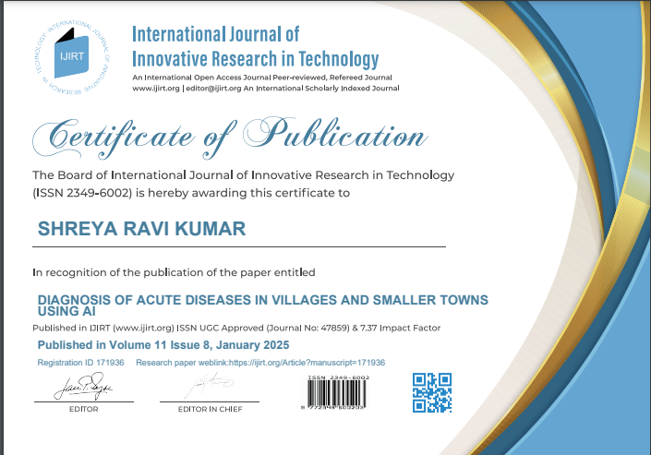
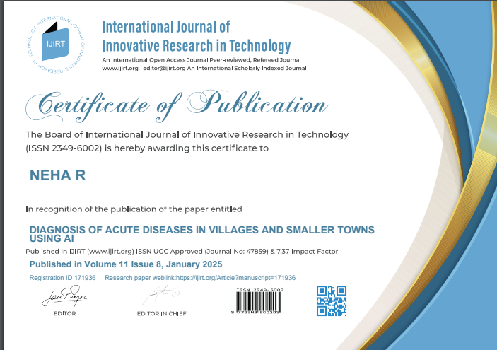
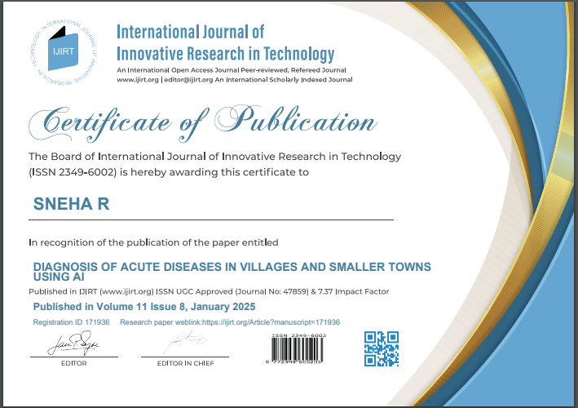
Achievements (if any)

Slide 22

Thank You

